Slide 1
CPE 301
Lab #07
Seven Segment Displays

Slide 2
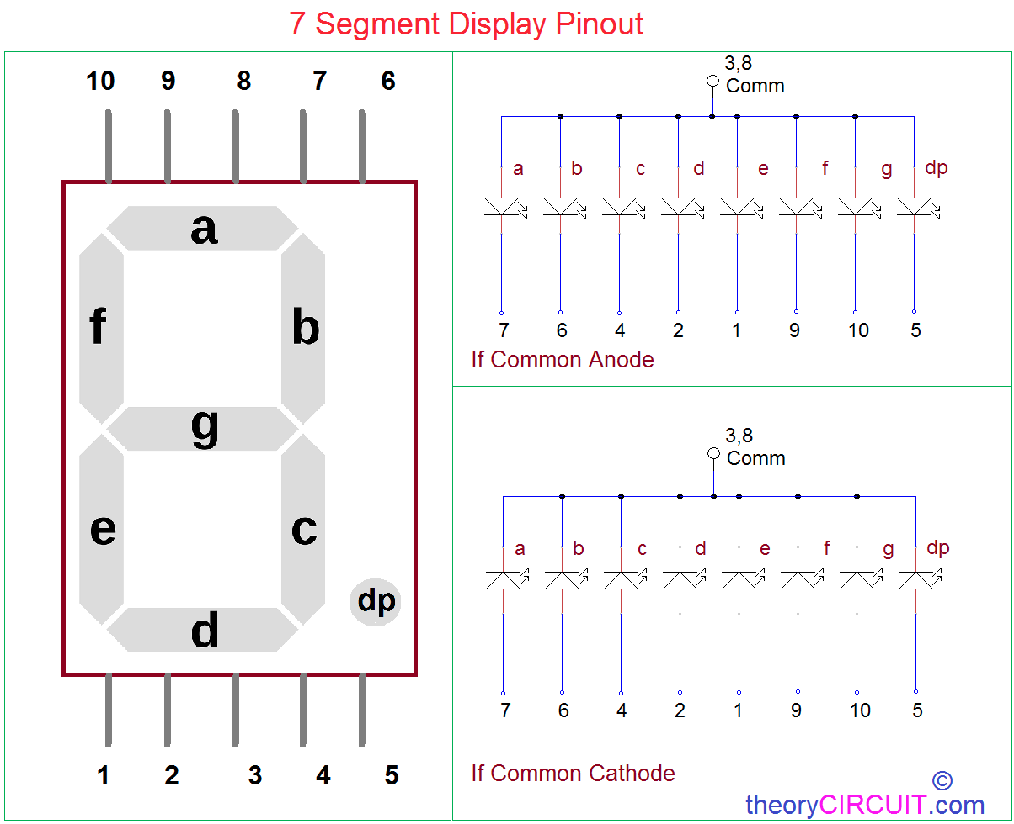

Slide 3
Task -
Arduino - Set 4 pins from a port as input
Arduino - Set 8 pins from a port as output
Input from switches as binary values - e.g. - 1111 (15₁₀)
Output to Buffer for 7-seg-display as HEX - e.g. input 1111 -> F
To display F in 7-seg we need to enable a,f,g,and e
Mask for a,f,g,e -> 1000111 (assume MSB to the left, Common Cathode)
Don’t use switch/if-else statements

Slide 4
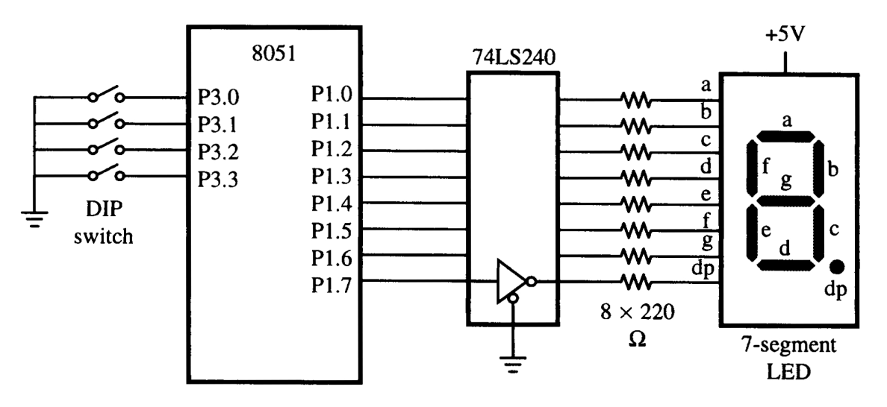
Arduino

Slide 5
Tips -
Remember your LSB/MSB!
Remember to use DIP switches Pull-up Resistors OR internal Pull-up Resistors
Test for common anode/common cathode first
Test pins for each segment. Make sure they all work individually
Double-check your masks for each individual display character

Slide 6
